Slide 1










Suivez-nous… www.linkedin.com/school/adrarnumerique
www.adrar-numerique.com

Slide 2












About Lady Catherine

Slide 3


Slide 4
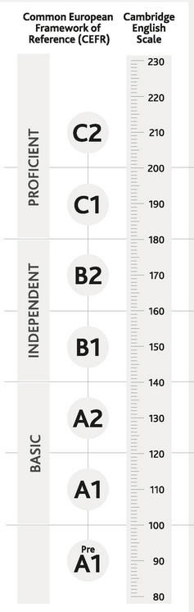

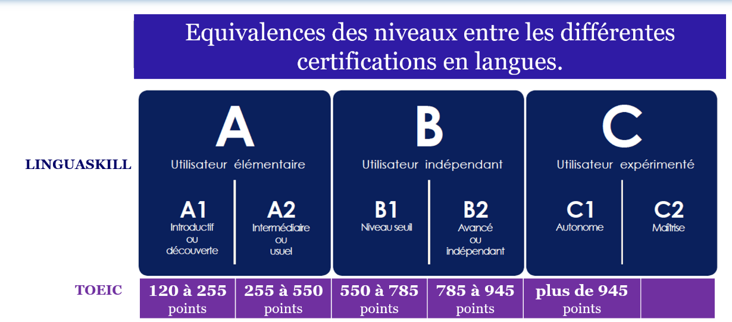


TOEIC SCORES CEFR (Common European Framework of Reference Languages) Your objective Fill up the stars ! & place you cv top of the list!

Slide 5
Review: Alphabet, Numbers, Symbols, tenses
Talk about you
Ask & talk about requirement specifications
Write (an abstract) & Talk about a project orally
Give a demo of a website & its features
Write a professional email
Programming Languages Vocabulary comprehension
Training Content

Slide 6
Exams requirements
1 Written
A Write an abstract (summary) of your project: 250 words minimum
B Read a document in English:
1/ answer 2 MCQ questions in English
2/ answer 2 open questions in English one including 750 characters maximum (spaces not included) and a second one including 550 characters maximum (spaces not included)
2 Oral 3 to 5 mn
Using powerpoint,
About you
About your project
About your company / internship

Slide 7
Useful websites to browse
www.wordreference.com
www.deepl.com/translator
https://agendaweb.org/
https://www.businessenglishsite.com/
www.breakingnewsenglish.com
https://www.ispeakspokespoken.com/cours-anglais/#Cours-danglais-pour-avances
https://global-exam.com/blog/fr/general-english-combien-de-temps-pour-apprendre-langlais/
https://www.naturalreaders.com/online/ & https://texttospeech.io/
www.proprofs.com/quiz-school/topic/computer

Slide 8
Useful websites to browse
Technique pour retenir le vocabulaire:
https://www.youtube.com/watch?v=Asmt1ws1ogw&list=PLpXDfP--B5esxM6zbiNUj_Tws-uGbEVPb&index=2
Email professionnel en anglais - partie 1
https://www.youtube.com/watch?v=xn1st-yv2kI&list=PLpXDfP--B5esxM6zbiNUj_Tws-uGbEVPb&index=14
Email professionnel en anglais - partie 2
https://www.youtube.com/watch?v=t5I_c5w9rUM&list=PLpXDfP--B5esxM6zbiNUj_Tws-uGbEVPb&index=15
Vocabulaire de l'informatique en anglais - partie 1
https://www.youtube.com/watch?v=-ReQcfZgm9w&list=PLpXDfP--B5esxM6zbiNUj_Tws-uGbEVPb&index=28
Vocabulaire de l'informatique en anglais - partie 2
https://www.youtube.com/watch?v=z3nrxcffbfI&list=PLpXDfP--B5esxM6zbiNUj_Tws-uGbEVPb&index=29
Vocabulaire niveau intermédiaire et avancé: mots et expressions
https://www.youtube.com/playlist?list=PLpXDfP--B5esxM6zbiNUj_Tws-uGbEVPb
Grammaire anglaise niveau intermédiaire et avancé
https://www.youtube.com/playlist?list=PLpXDfP--B5evNTAKT6qxxELb3QSP2Nz_d
Dictées
https://www.youtube.com/watch?v=AQ6yEINNZMs&list=PLpXDfP--B5esLa0TC2b5e00HFX9-8zyVc

Slide 9
Let’s go for the placement Test!

